Slide 1
What I’ve Done This Year
Jordan Tice

Slide 2

01
Learning Unreal
This was what I did when we first started class.

Slide 3
The first several class periods were spent learning about Unreal and what exactly I would be able to do using it. In order to learn more about it I used various tutorials, and the documentation for Unreal, to try different things and see how those worked. This made it easier for me to figure other things out and begin to do more with the software.

Slide 4
02
Movement
The movement of the character in the game.

Slide 5
Once everyone in the class new some basics, we split into groups to begin slowly building the game, and the one I ended up in focused on movement. I was able to focus more on one thing, and now I have some knowledge on how to combine the movement of the character with various animations for the various movements and actions.

Slide 6
03
Cutscenes
The cinematics in the game

Slide 7
I ended the year working on both learning how to create cutscenes, and doing as many cutscenes as I could manage for the physical game. However, due to several errors in attempting to pull all of the needed content, I was unable to complete as much as I wanted to.

Slide 8
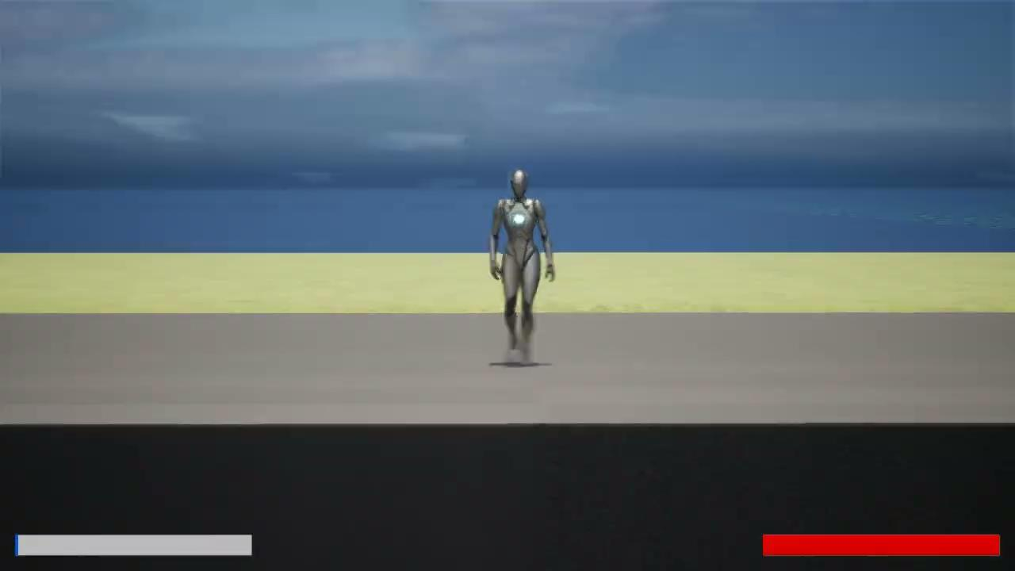
Example :

Slide 9
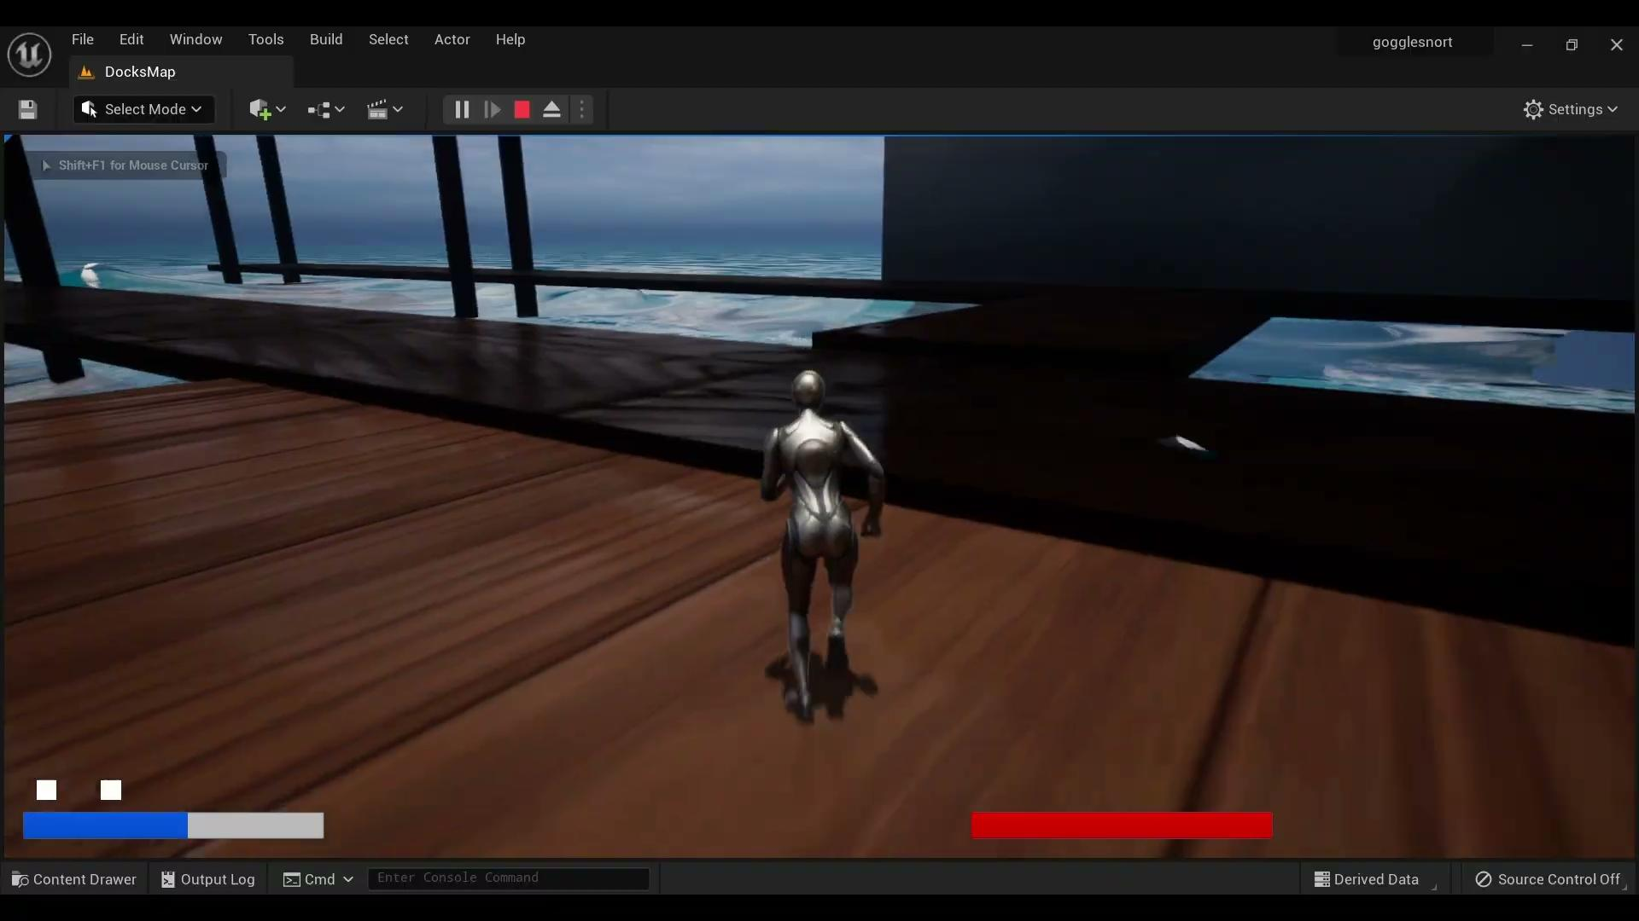
Example :

Slide 10
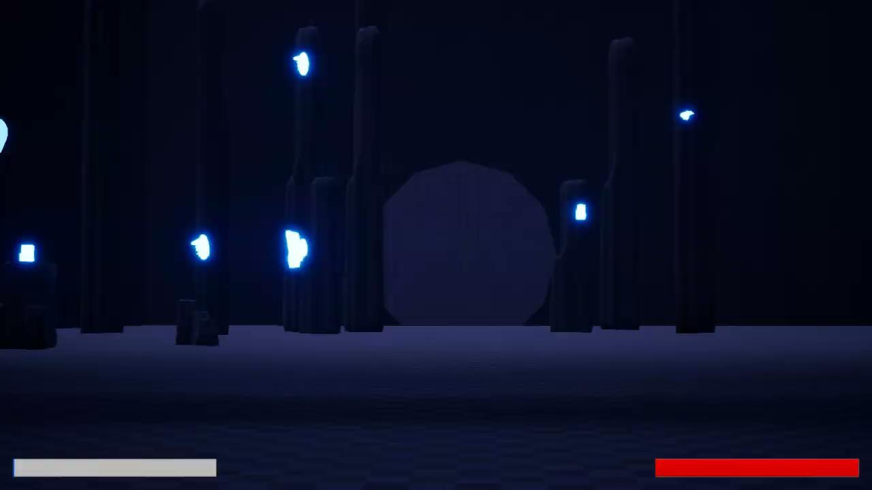
Example :

Slide 11
Thanks for Listening!!!

